Slide 1
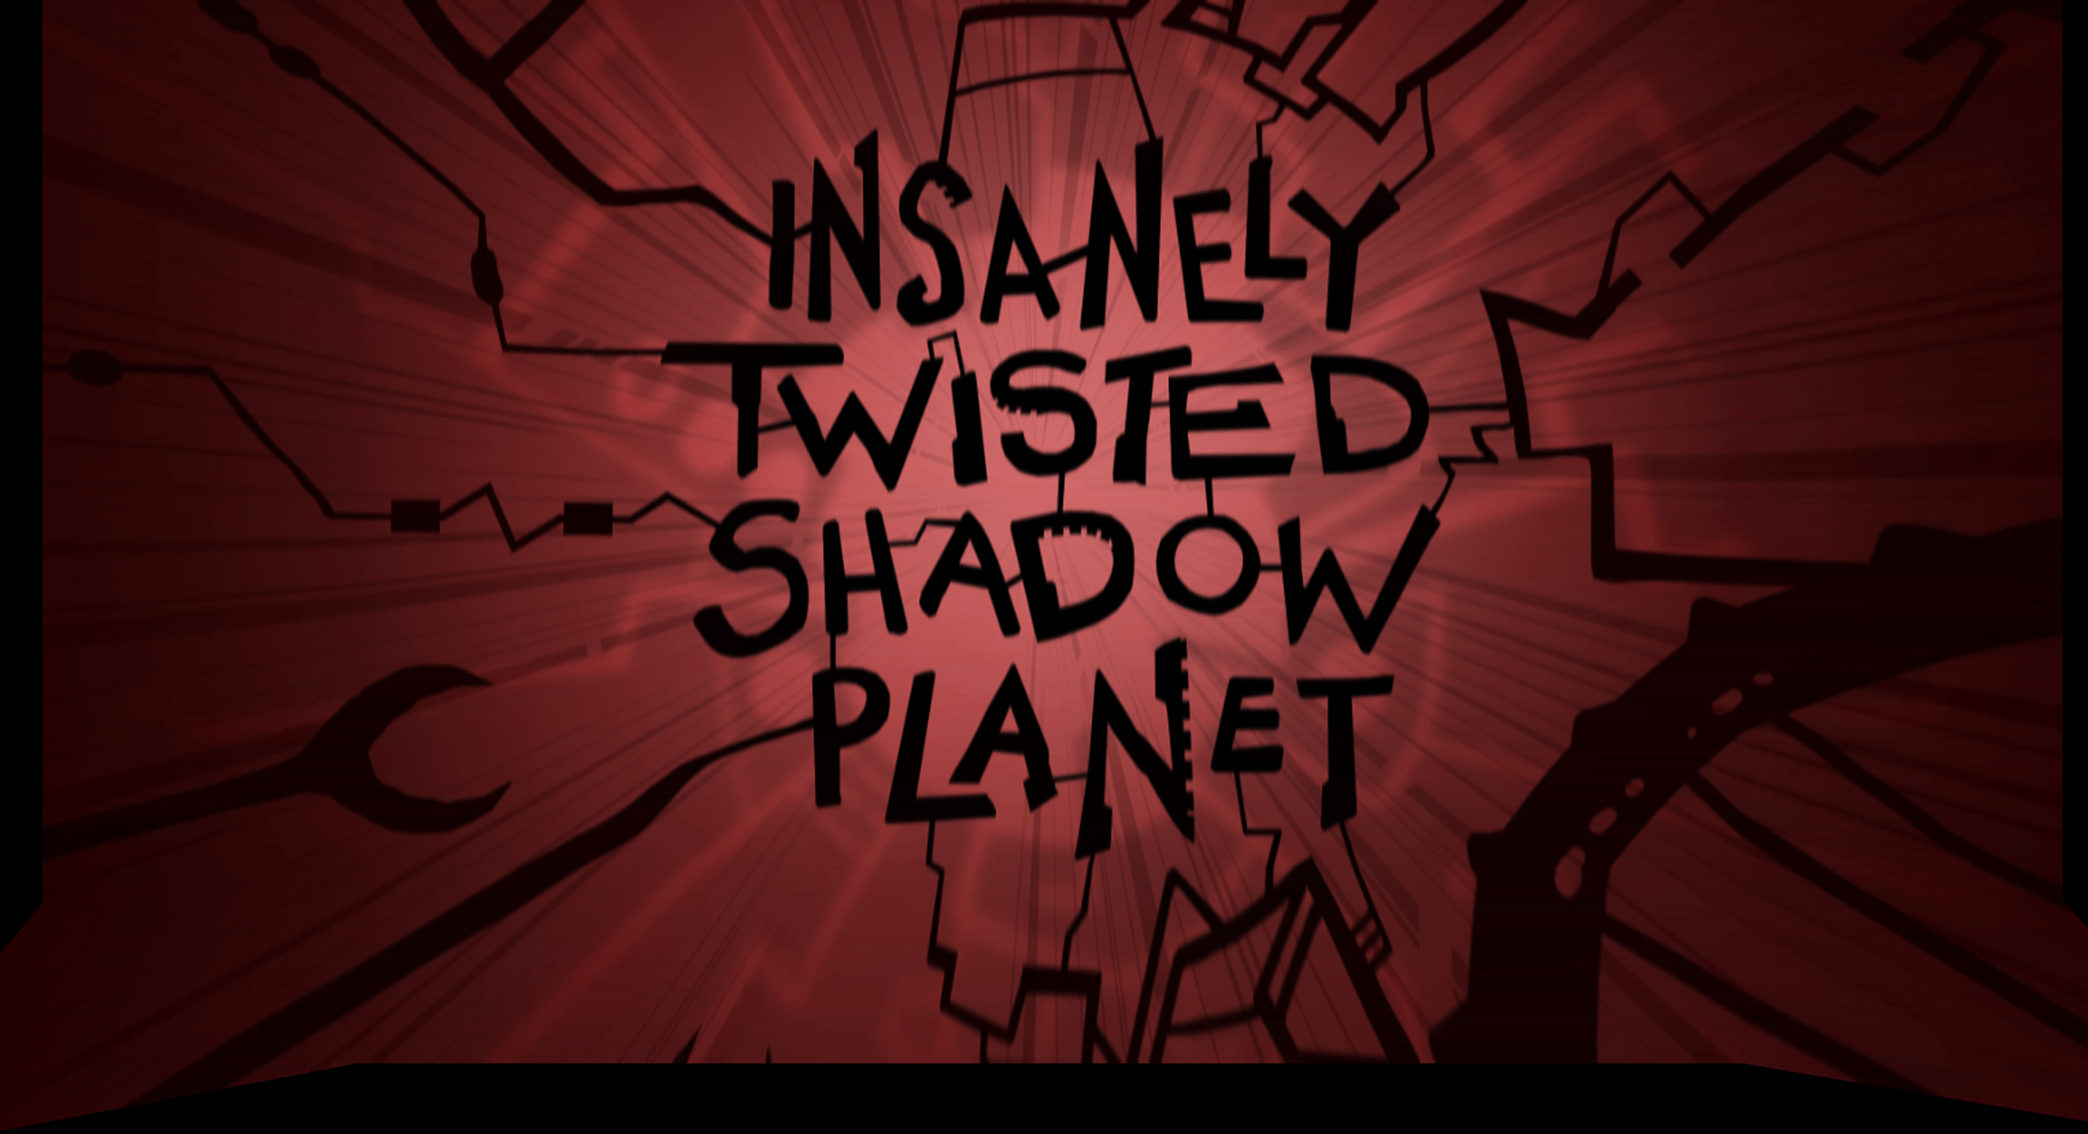

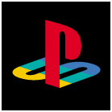
Concept Presentation
Eric Koch
November 18, 2009
Santa Monica Studio
Notes:
I’m here to talk about a new concept we are looking at for the NGP called Insanely Twisted Shadow Planet
FINAL VERSION – 11/17/09 – 5:00 PM

Slide 2

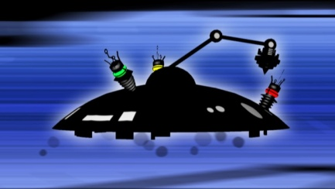
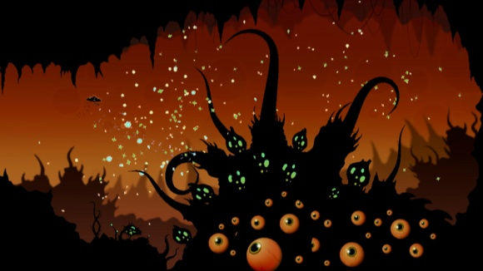

Genre, Platform, & Audience
Genre
Adventure Shooter
Platform
NGP
Audience
Fanatical / Committed / Core / Casual
Product Scope
Mid-Size
NGP Features
Front Touch / Back Touch / Microphone / Camera
Santa Monica Studio
Notes:
We see it as an action/puzzle game. So while there is a lot of exploration the primary focus is action based shooting.
While the game will have the pick up and play hooks that appeal to casual gamers we feel the art style and depth of the experience will also appeal to the more traditional Sony fanbase.
The game is too large to be considered a snack sized NGP app but it also isn’t a full blown AAA sized game. We feel it fits very comfortably into the mid sized game category.
The primary focus on bringing this to the NGP is front and back touch and the microphone but there are also some great ideas for motion and the cameras.

Slide 3
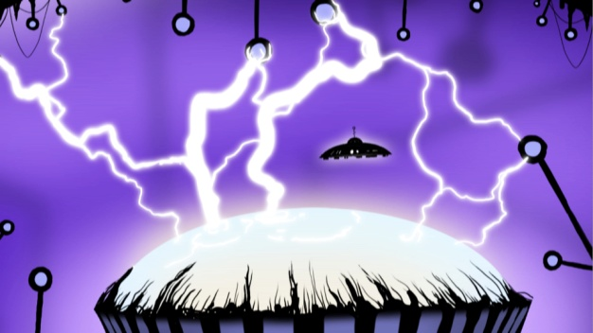
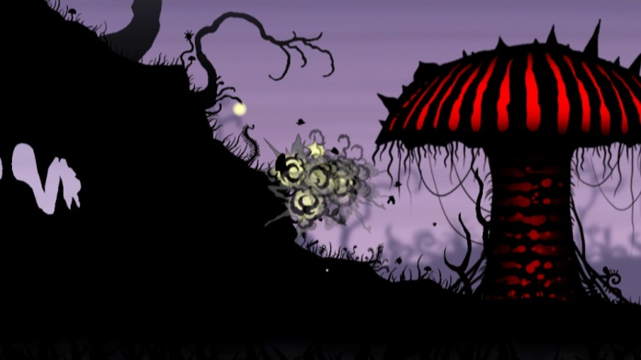
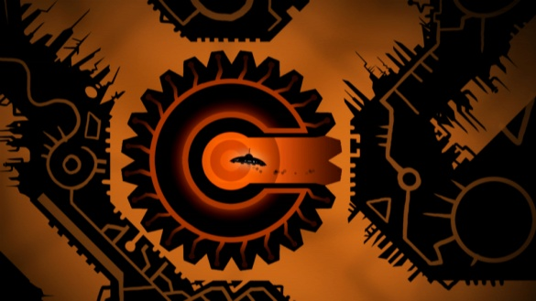
Purpose of Meeting
Overall Purpose
Concept Greenlight Preview
Feedback Required
NGP as Primary Platform
International Appeal and Relevance
Santa Monica Studio
Notes:
Were hoping to get feedback on the concept in general and hear thoughts on the game as an NGP title and well as hear from SCEE if the title might have some appeal in Europe.

Slide 4
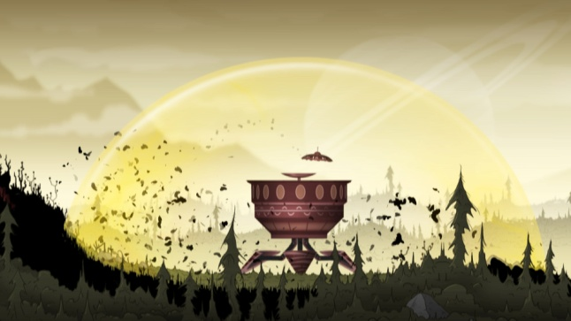
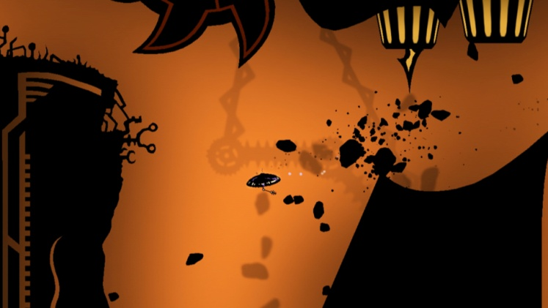
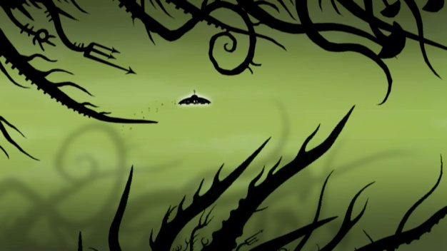
Portfolio / Strategic Fit
    Key Initiatives Supported
    Deliver exclusive new IP yearly
    Create exclusive showcase launch titles for new platforms
Santa Monica Studio
Notes:
We feel that Insanely Twisted focuses on two key areas within are strategic initiatives.
For one it is going to be a new and exclusive IP that has multiple avenues for expansion and number two, it will be a showcase title for the launch of the NGP both graphically and that exploits the unique feature set of the device.

Slide 5
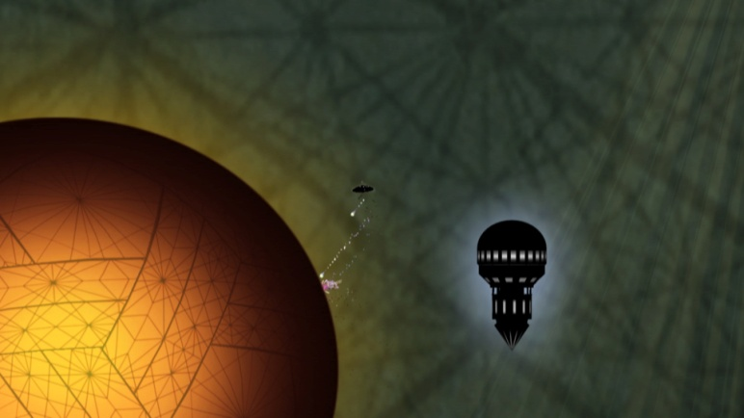
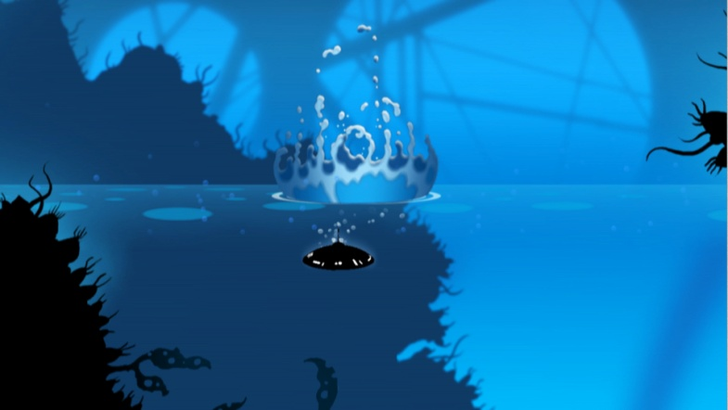
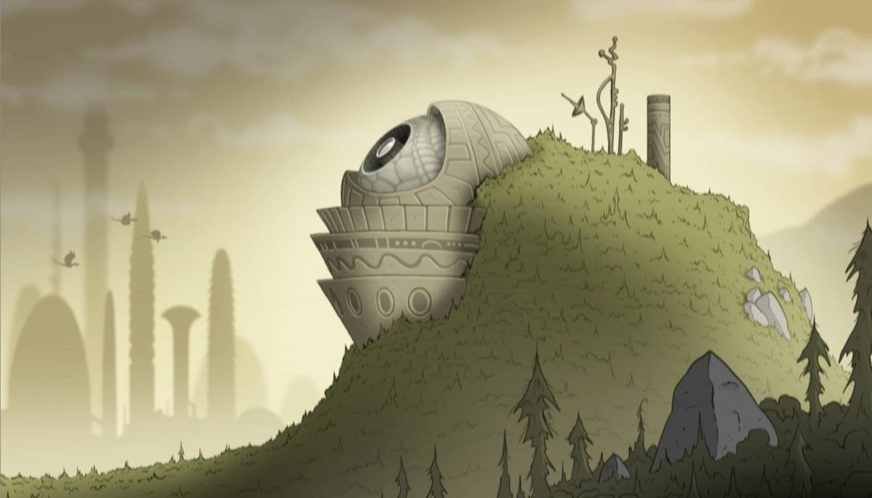
High Concept
“Discover strange untamed planets”
Santa Monica Studio
Notes:
5
Insanely Twisted Shadow Planet is about exploring unique and beautiful worlds

Slide 6

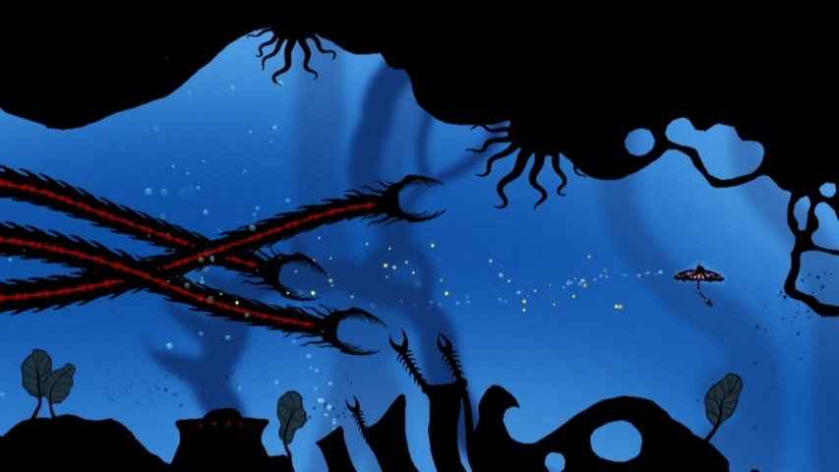
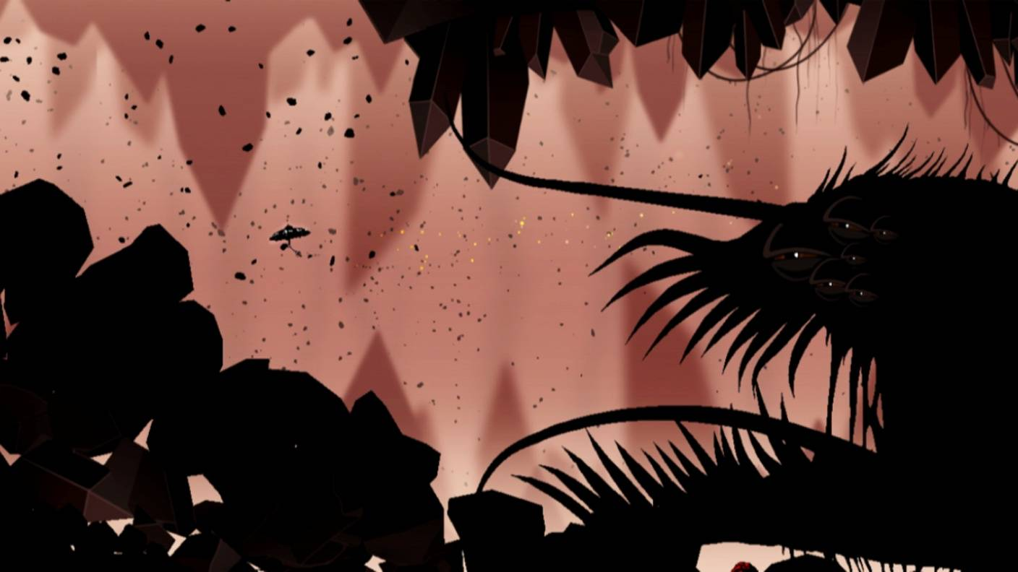
High Concept
“Battle incredible monsters!”
Santa Monica Studio
Notes:
Battling unbelievable and incredible monsters

Slide 7
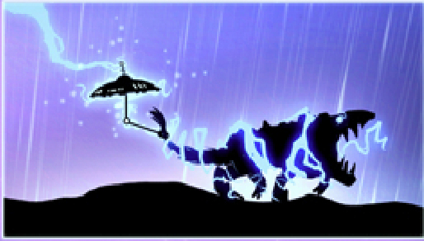

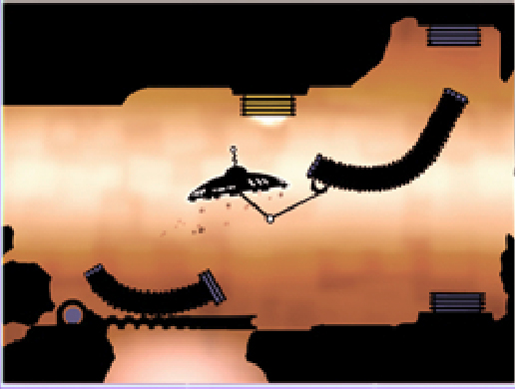
High Concept
“Interact with amazing creatures and machinery!”
Santa Monica Studio
Notes:
And solving puzzles involving creatures, machinery, and the planets themselves.

Slide 8
Game Play Video
Notes:
Here is a small video put together that shows gameplay

Slide 9
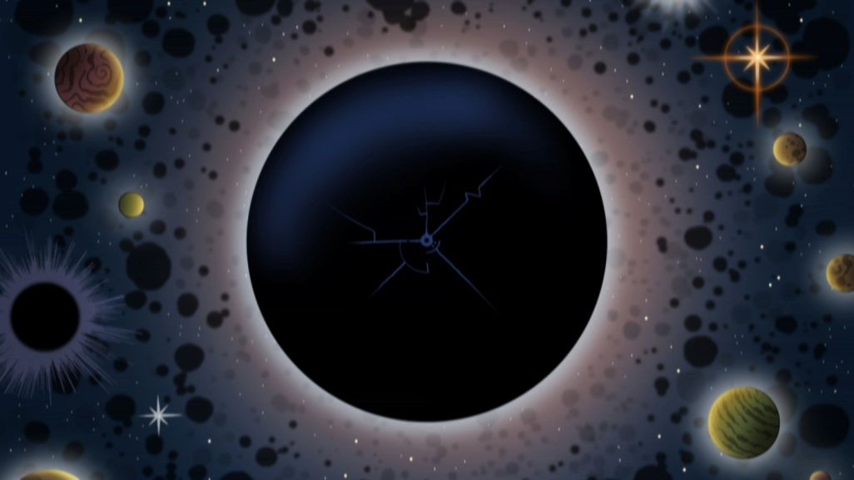
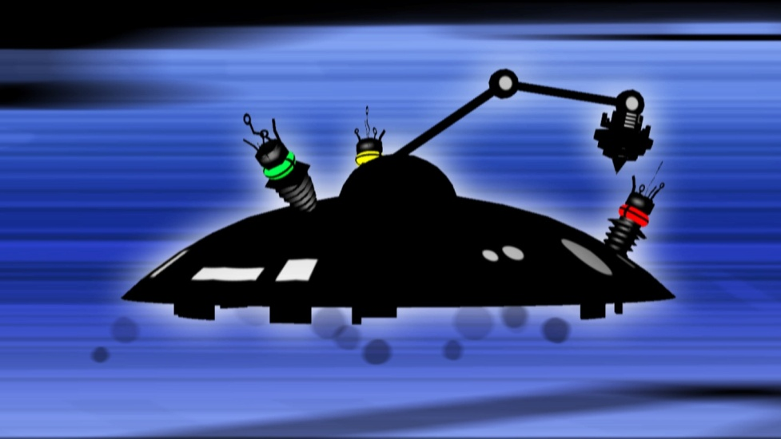
Story,Theme & Tone
“A mysterious dark substance has overrun the solar system, threatening your world. Sent out as your planet’s last hope, you must find its source and stop it from destroying everything.”
Santa Monica Studio
Notes:
The premise for the story is that a mysterious dark substance has overrun the solar system and is threatening your home world. The player is sent out as their planet’s last hope to find the source “dark substance” and stop it from destroying everything.
Were billing this as a dark action packed 2-D side scroller with an emphasis on high quality 2-d animation

Slide 10
Core Experience & Key Features
“Uncover the mysteries of each of the shadow planets and their insanely twisted enemies and puzzles.”
Key Features
Explore unique and gorgeous worlds
Solve brain teasing puzzles
Collect the planets inhabitants and watch them interact
Unique NGP interactions showcasing the hardware
Santa Monica Studio
Notes:
Core Experience
So at it’s core Insanely Twisted Shadow Planet is about exploring and uncovering the mysterious of fantastic worlds while dealing with imaginative enemies and solving puzzles.
Key Features
Exploration of the strange planets
Solving Fun and unique puzzle
Collecting and interacting with planet’s inhabitants
And a host of unique NGP features

Slide 11
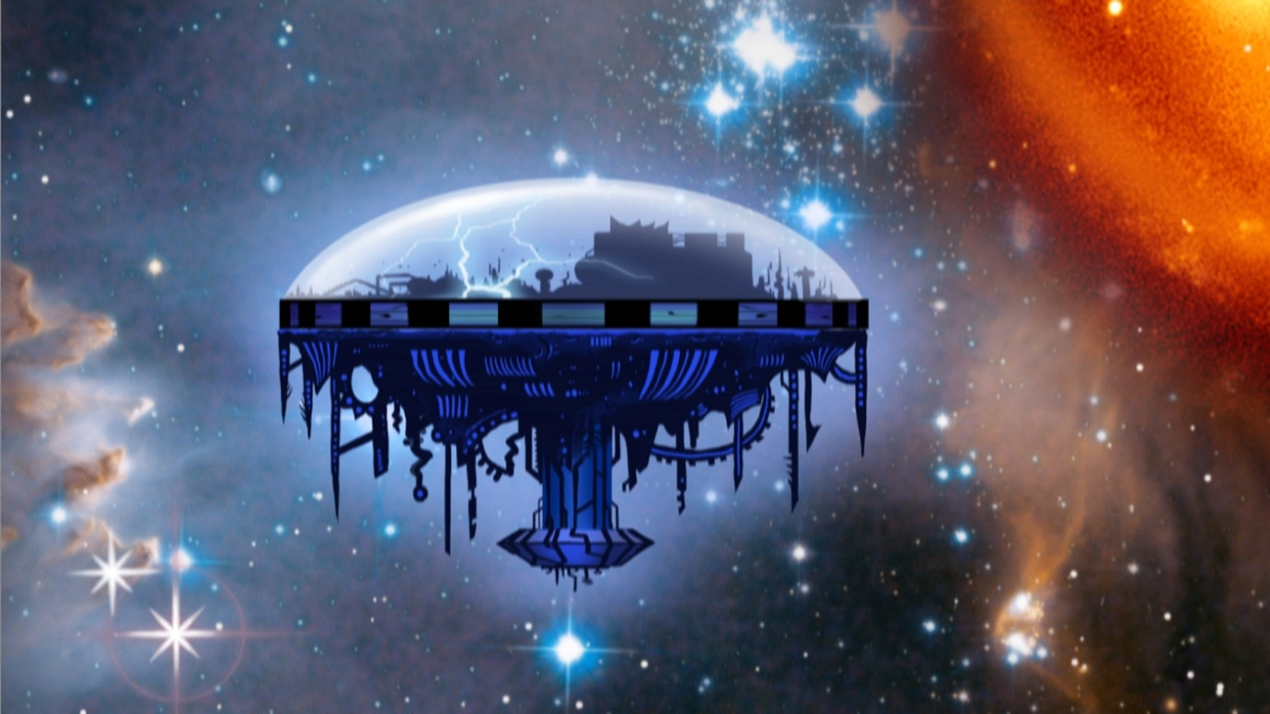

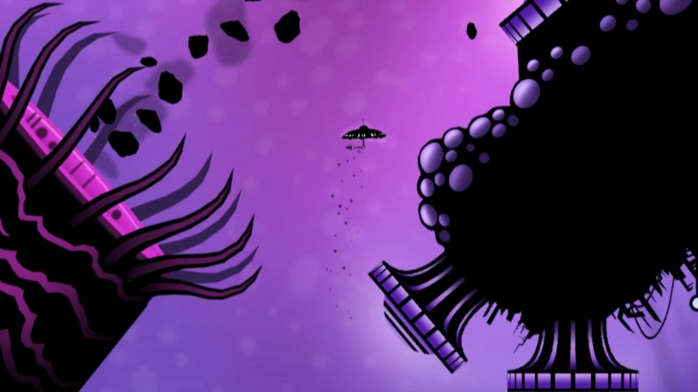
Unique Worlds
Santa Monica Studio
Notes:
There will be approximately eight different planets for the players to explore. Each will look completely different, contain different creatures and inhabitants and bosses. Each planet will also showcase new mechanics.
The plan is for the player to be constantly having new experiences, being rewarded for successfully navigating the treacherous terrain and pushing the player towards the unknown.

Slide 12
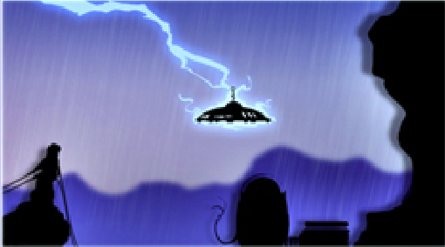
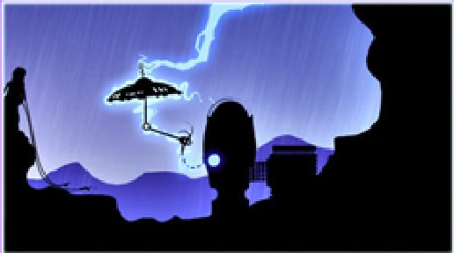
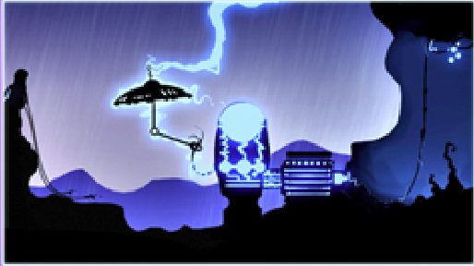
Intuitive Puzzles
Santa Monica Studio
Notes:
You ship will have 8 different attachments that the player will use to either progress or find secrets.
For example here we have a lightning filled planets. You’ll notice here that the lightning strikes their ship and that this machine has no power. If they grab the wire running from the machine and the lightning strikes them it will power up the generator opening the door.
So they are clever, yet simple and easy to understand

Slide 13
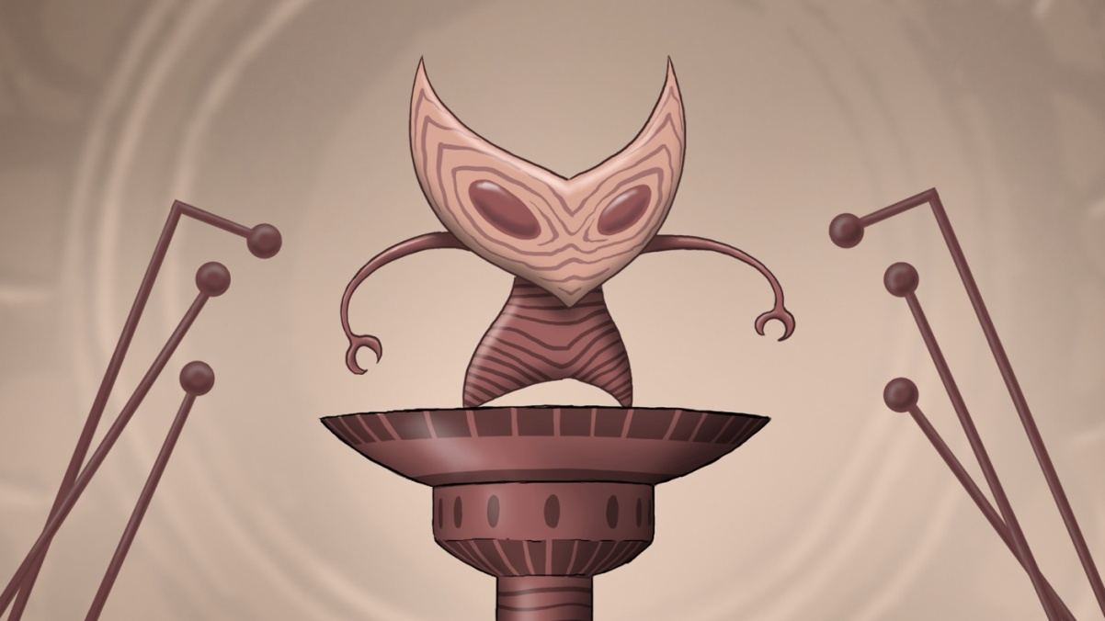
Collecting
“All creatures can be captured, adding an element of collecting to the game.”
Santa Monica Studio
Notes:
Each plante will have a wide variety of creatures that can be captured and experimented with. You'll be able to collect every creature (except bosses) and drop them off in new locations. When you put these little guys next to new creatures, they'll do everything from mating with each other to fight till the death. When they fight it out, well one side wins, when the mate, they'll create new creature combinations and potentially creating new characters and opening up secrets. There is also the potential for their to be a small trading element allowing players to trade different creatures they have collected with friends and a mild social component to the entire game.

Slide 14
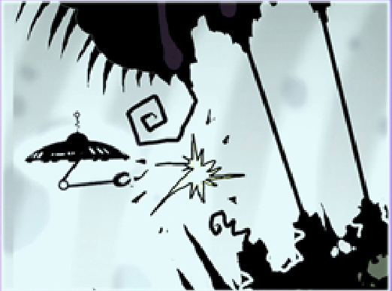
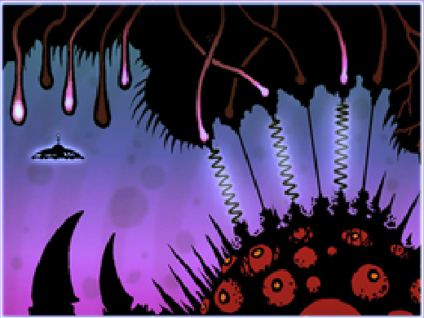
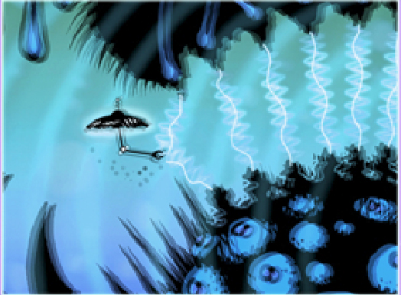
Unique NGP Interactions
Back Touch
Santa Monica Studio
Notes:
One thing the development team has focused on in the past few months is utilizing as many unique features on the NGP as they can. Here is an example of a puzzle that will use back touch. There is a monster that the player needs to get passed that is emitting sound waves. The player must grasp the “strings” that are emitting these waves, and strum the back panel in sync causing dissonance that will break the string.
There are more examples of back touch controls including guiding spotlights, tapping the back screen to make hidden creatures emerge, and finding seams and literally tearing holes in the levels.

Slide 15
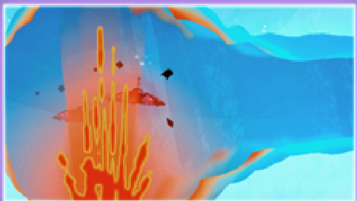
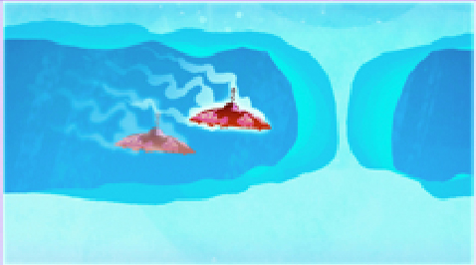
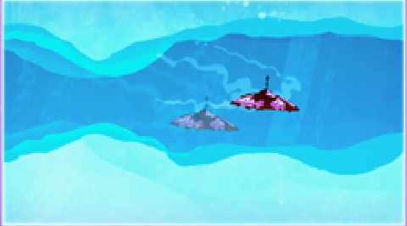
Unique NGP Interactions
Microphone
Santa Monica Studio
Notes:
Here’s another unique NGP feature that uses the microphone to help your ship break through an ice wall. To do this the player must heat themselves up in a lava vent and then blow into the microphone just enough to keep them from over heating as they move to the ice wall which they can no melt. After they can fully blow into the microphone to put out their ship.
Other uses of the microphone include scaring away clusters of enemies, stoking a fire, or creating massive sound blasts which stun enemies.
Some other components specific to the NGP we are looking at including in the game are using the front touch to draw a path for a missile to follow, using the accelerometer to shake away snow that has accumulated over passages, and covering up the camera to make nocturnal creatures emerge or blind certain enemies. The teams very excited to be working with such a unique new interface and has a large list of other ideas.

Slide 16
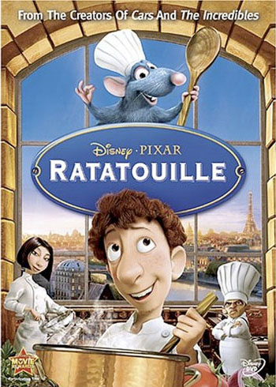
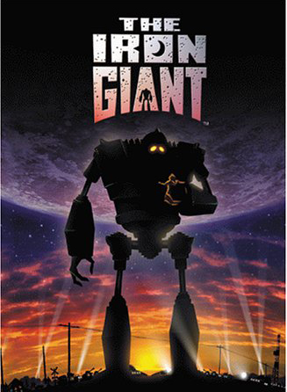


Art & Animation Direction
“High quality Art and Animation by Michel Gagné.”
Santa Monica Studio
Notes:
All art an animation is being concepted or created by Michel Gagne whose iconic style can be seen in the Iron Giant as well as Pixar films such as Ratatouille and the Incredibles

Slide 17
Business Case

Slide 18
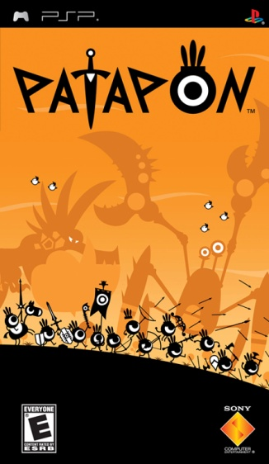
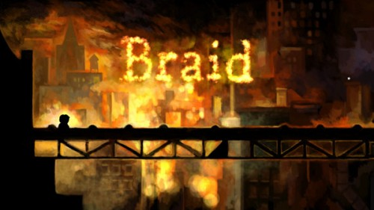
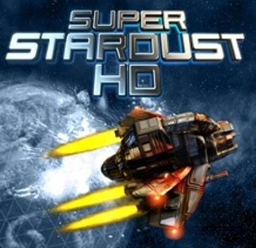
Competitive Analysis
Santa Monica Studio
Notes:
We think it mixes elements of all three the unique puzzle mechanics of Braid, the art style of Patapon, and the pick up and play fun shooter mechanics of Super Stardust.

Slide 19


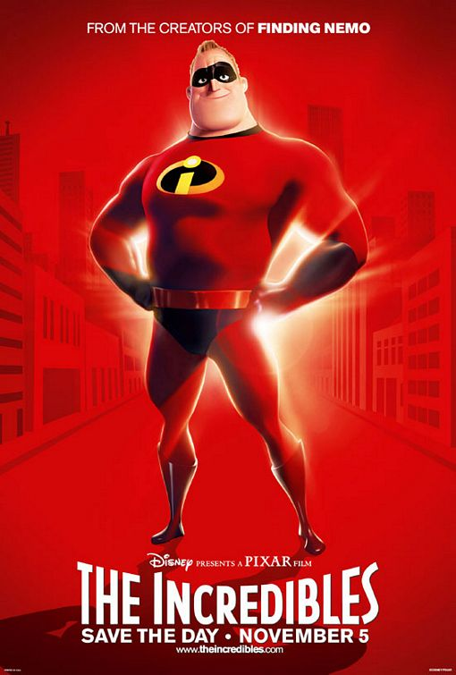
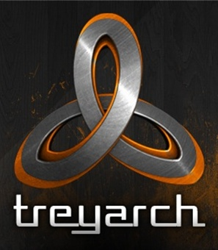

Team Heritage
“Looks like the kind of game a lot of people would like to play.”
-Kotaku
Santa Monica Studio
Notes:
The team creating the title is a new group called Fuel Cell. They are a group of industry veterans with team members having worked on a variety of high successful products.
If you haven’t seen this game already, there is a huge amount of buzz about Insanely Twisted Shadow Planet found through out blogs and message boards. We think this game already has a decent amount of momentum and we want to do our best to capitalize on that.

Slide 20
Risk & Success Factors
+
Playable demo is very fun and shows immense potential
Creator Michel Gagne is a world renowned artist with an iconic style
Team has very creative and achievable goals for NGP mechanics
Game design has broad crossover appeal to multiple audiences
-
New Team (most have worked together for Midway/Treyarch)
New Hardware
New to Next Gen Console
Santa Monica Studio
Notes:
For success factors we have great game director and art director but an even better demo. We feel our goals are all achievable and the game shuold appeal to a wide variety of gamers.
Things we need to watch closely are the fact that this is a new team. Most of the guys have worked together for big dev studios but a new team is still a bit of a risk. Were also up against the same risk factors as all the other NGP titles with unfamiliar hardware. It’s also important
Sony will have “interactive” IP right only

Slide 21
Project Scope
Product Scope – mid-size
Development:18 months/9 team members (NGP launch)
Budget (including Sony production) – $1.8M
Break Even ($19.99 RPP w/$1M Marketing) – 176K units
15% ROI ($19.99 RPP w/$1M Marketing) – 207K units
35% ROS ($19.99 RPP w/$1M Marketing) – 359K units
Santa Monica Studio
Notes:
We’re looking at a mid-sized game (ready for launch) with about 18 months of development inlcuding pre-production with a managebale team size of 9 guys. The full dev and production budget comes in under 2 Million and we have very reasonable break even figures.

Slide 22
Summary
We will deliver a innovative 2D adventure/shooter that appeals to the broadest spectrum of the Sony audience. In doing so we are taking a traditional genre and re-inventing it with gameplay that could only be experienced on the NGP!
Santa Monica Studio
Notes:
So to wrap things up we feel confident this is going to be a great game with some very cool innovations that will really highlight the NGP and expand the platform as well as live up to the Sony level of quality we all expect.

Slide 23
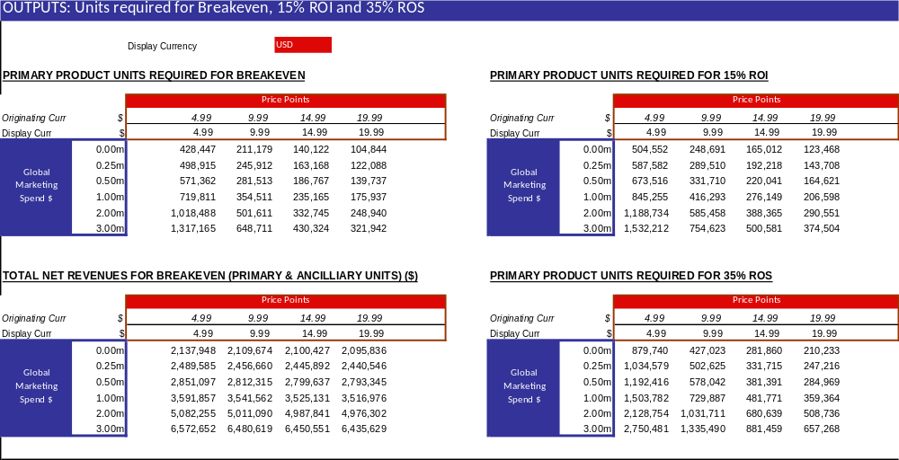
Breakeven, ROI & ROS
Santa Monica Studio

